Slide 1



Slide 2

Topics Covered
What is Left/Right
Key features
Agenda
Technologies that can be used
Business Model
Marketing Strategy
How are we different?

Slide 3

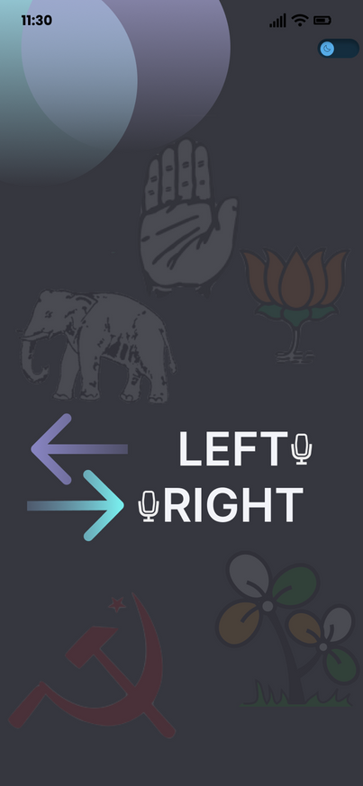
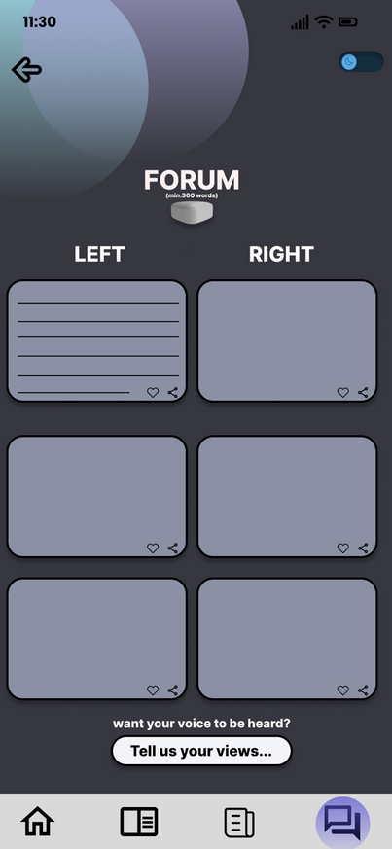
What is
Left/Right?
Go Back to Agenda Page

Slide 4

For beginners and people who have no idea about politics, it is quite a daunting task to get into politics.
Whatever source of information they use, there is always a bias - be it left wing or right wing.
For example, watching a certain Republic Television Channel isn't the most unbiased of choices, and neither is the contrary.
The Problem
Go Back to Agenda Page

Slide 5
Left/Right
Our app is a modified forum where people can post their opinions on political events and standings.
Users can see both left- and right-wing answers side by side, which allows them to form their own unbiased opinion.
The app does not have debates or people talking against each other, so users can focus on sharing their opinions.
We also give daily news flashes, and provide gamified learning options.
Our Solution

Slide 6
Helps users learn about politics and form their own unbiased opinions.
Provides a platform for users to share their opinions and connect with others who share their views.
Promotes civil discourse and understanding between people with different political views.
Benefits
Go Back to Agenda Page

Slide 7

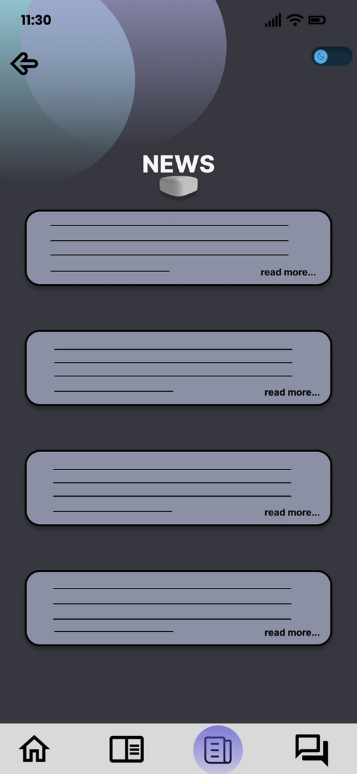
Features

Slide 8

Fact Checking
APIs & Models to fact-check user posts (eg. Google Fact Check API)
Polls
Vote on political issues and see how people's views compare to others
Gamified Learning
A fun way to learn a stereotypically boring topic

Slide 9
Multilingual Support
Promotes inclusivity and overcomes language barriers.
Resources
Scholarly resource sections with redirects to reliable educational resources.
Charitable Causes
Raising money towards noble causes

Slide 10







TechStack
Frontend:
Flutter
Backend:
Firebase/AWS Amplify
Python
Django
MySQL
Machine Learning (for fact-checking):
TensorFlow
Scikit-learn Mobile
Flutter
Firebase
mySQL
TensorFlow
Scikit-learn Mobile
Python Django

Slide 11

50
Business Model
40
30
20
10
0
Value Proposition
Target Market
Scalability
Revenue Model
Providing a safe space for users to share their opinions and learn about topics that are generally quite controversial.
Newcomers and inquisitive learners in the political scope.
Experts who would want to share their stands on a dedicated platform.
Every topic in this world has 2 sides to it, so this product isn't limited to JUST Indian politics, and can definitely by scaled up.
Advertisements
Freemium Model with exclusive perks and ad-free benefits in the premium pack
Content Licensing.

Slide 12
Revenue Model
Content Licensing: License unique content to media outlets, educational platforms, or publications.
Exclusive Interviews: Offer premium access to in-depth interviews.
Exclusive Access: Provide premium membership for live Q&A, debates, and community forum.
Native Content Ads: Integrate sponsored content seamlessly.
In-App Advertising: Display targeted ads.
Sponsorships: Collaborate with organizations for brand exposure and promotions.
Content Licensing
25%
Advertisements
50%
Premium Plan
25%

Slide 13

Marketing Strategy
Strategy | Media used | Advantage
Paid advertising | Google Ads, Meta Ads, Twitter Ads | Reacing a large potential user base
Social Media | Engaging content, contests, posts etc. on SM apps like Instagram & Facebook | Emotional connect with potential users and promote the app
Public Relations | Press releases, pitching stories to journalists, and attending industry events | Generate positive media coverage for the app
Word-of-mouth | IRL | Spreading the word about the app

Slide 14



How are we different?
We focus on education, not debate. Our app is designed to help people learn about politics, not to argue about it. We do this by using a minimum word limit, fact-checkers, and hate speech removal to filter out irrelevant and harmful content.
We present both sides of the story. We want our users to be able to see all sides of an issue, not just one. That's why we display opinions and facts from both left-wing and right-wing perspectives.
We are committed to accuracy. We use a variety of sources to ensure that the information on our app is accurate. These sources include fact-checking organizations, academic journals, and news outlets.

Slide 15

Thank you!
-Aastik, Kushagra & Manan

